Slide 1
Sfl
Door-Tran is a creative community network dedicated to connecting people to transportation services that are affordable, available, and accessible.

Slide 2
How We Started
United Way of Door County began the initial steering committee, which is now a Consortium of 40+ members ranging from government, non-profit and for-profit providers, agencies and private citizens.
Door-Tran became a 501c3 in 2009 and continues to lead the partnerships between all Consortium members.
Continued communication is key to expand
services based on rider and provider needs

Slide 3
Initial Partnerships to Research Needs
Partnered with UWGB to complete a resident survey to find what people were willing to do and what deterred them from getting where they needed to go
Launched a call center to track unmet needs and to provide information and referral services. Contracted with a local agency for staff, space, etc.
Partner agencies and providers also tracked unmet needs of clients and riders

Slide 4
Partnerships to Meet the Needs
Half-Price Travel Voucher Program
New Freedom and local funds obtained to subsidize trips with local taxi companies
Funds also used in partnership with the Washington Island Community Health Program and Door CANcer to subsidize trips with the Ferry as needed
Partner with the YMCA, Boys and Girls Club, Ministry Medical Center and other organizations to reduce their transportation costs
Have subsidized more than 16,000 trips since November 2009

Slide 5
Partnerships to Meet the Needs Cont.
Veteran Volunteer Transportation Program
Collaboration between non-profit, Door-Tran, government to include the County Veterans Services Office and the County Senior Resource Center
County contracts with Door-Tran to market program for volunteer drivers and riders in addition to training drivers, scheduling trips, and maintain mandated reporting
State 85.21 (Older Americans Act funding) and a Veteran Transportation grant funds support the program
Have served more than 80 Veterans and provided more than 500 trips since February 2011
Sunshine House, Inc. Need for New Fleet
County of Door received ARRA funds and were able to lease 6 buses and 1 van to the Sunshine House, Inc. a local 501c3
If the Consortium wasn’t launched, the County would not have known the need of the Sunshine House
Sunshine House now serves as a Connector for our public transit system, Door 2 Door Rides

Slide 6
Partnerships to Meet the Needs Cont.
Public Transit launched August 2010
Collaboration between non-profit, for-profit, and government to include Abby Vans, Sunshine House Inc., and the County Senior Resource Center
System has grown from 2 shared ride taxi’s in 2010 to 6 shared ride taxi’s and 7 buses in 2013
Rides have increased from 19,202 to 29,000 in 2012. The first 6 months of 2013 there have been 18,000 rides already provided.

Slide 7
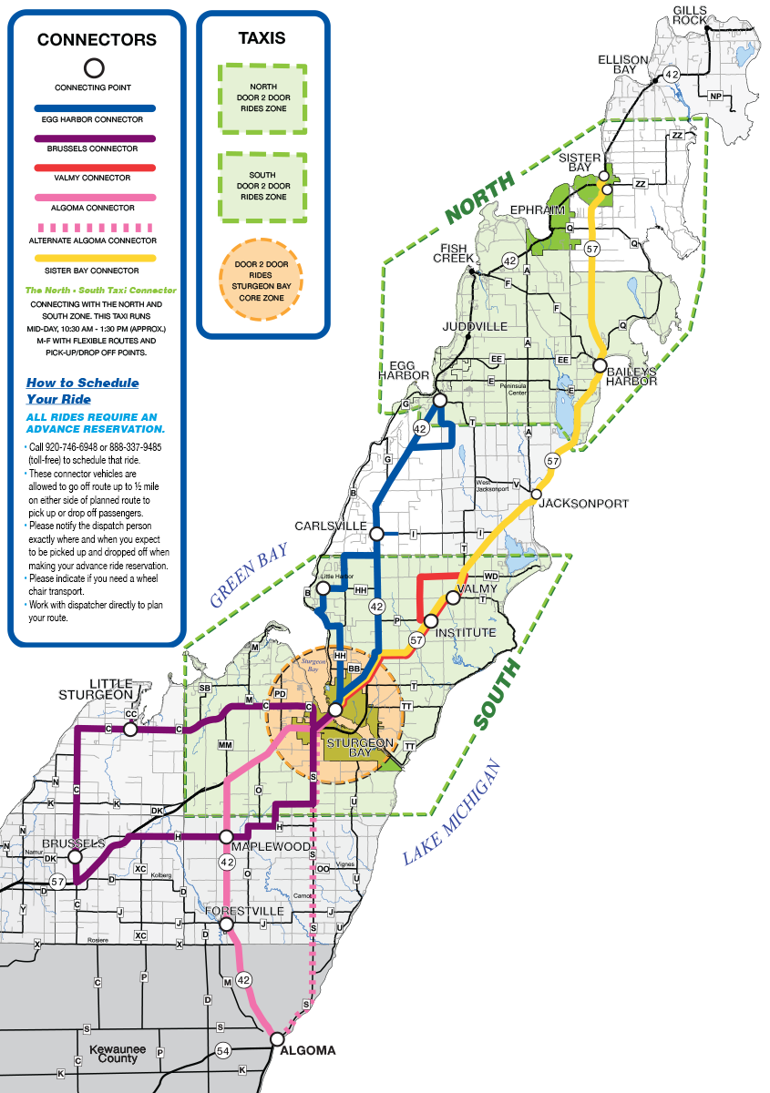
Door 2 Door Rides & Connectors

Slide 8
Door-Tran Pam Busch, Mobility Manager 1300 Egg Harbor Road, Suite 124 Sturgeon Bay WI 54235 920/743-9999 or 877/330-6333 Email: info@door-tran.com Website: www.door-tran.com
To learn more about creative transportation projects in Door County, please contact Pam Busch, Mobility Manager

