Slide 1
Valley Transit
Fixed Route and ADA Paratransit Transportation

Slide 2
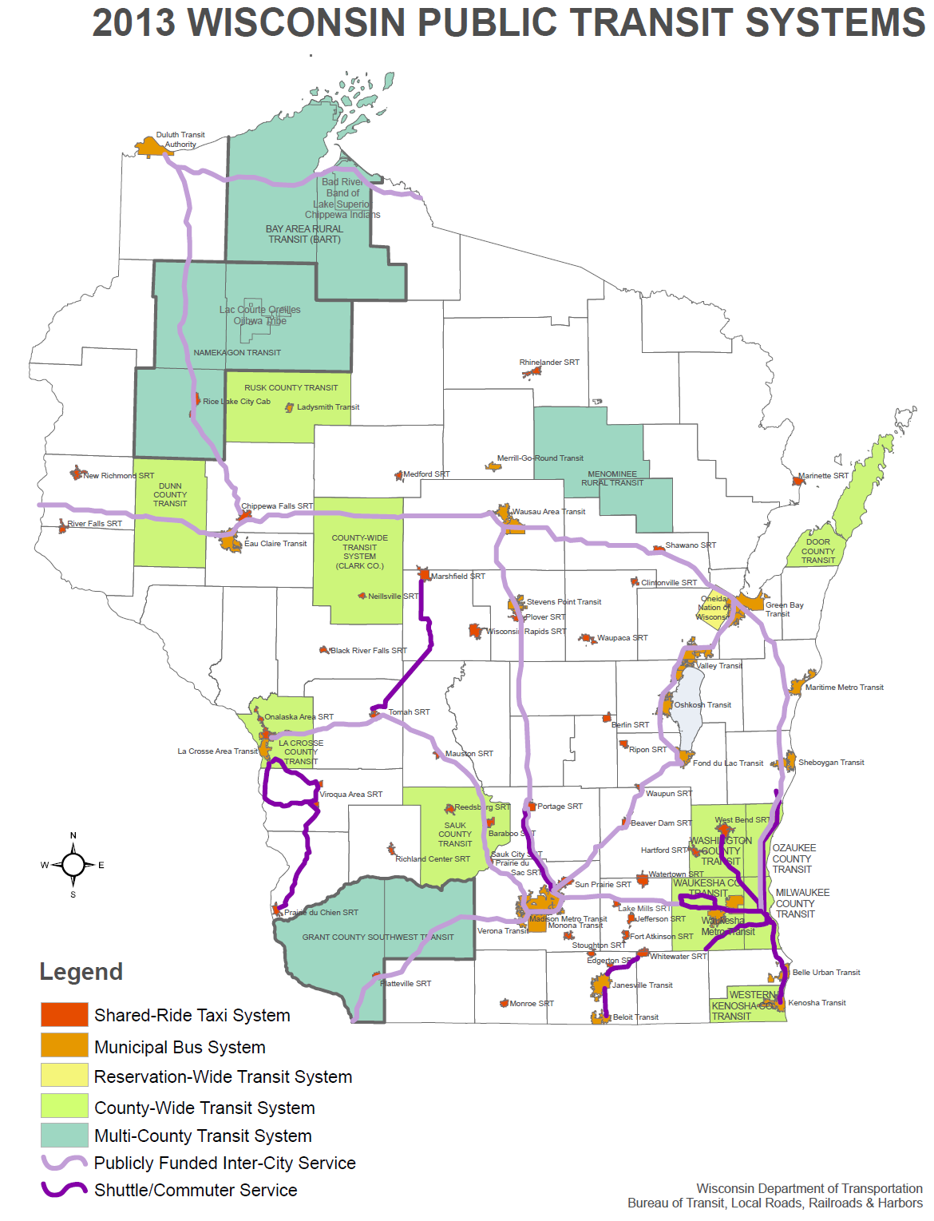

Slide 3
Why is transit vital to the communities they serve?
Transit connects people to the services they need in their community:
Employment
Education
Medical appointments
Other daily needs
Transit helps people become more self-sufficient.

Slide 4
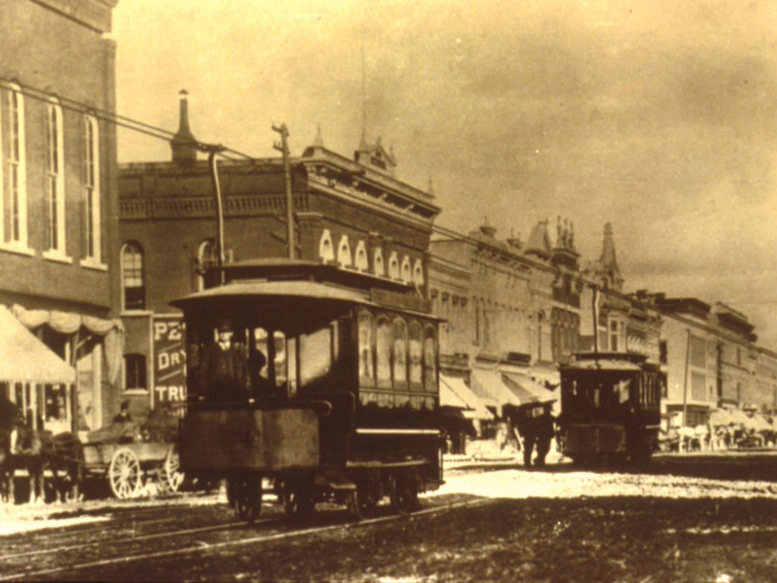
August 1886 – April 1930 Electric streetcars
On August 16, 1886 the Appleton Electric Street Railway Company began operation of the world's first commercially successful electric street railway. The cars were driven by Van Depoele direct current motors which received power from a hydroelectric generator through two trolley wires.
In 1930, the expanded electric street railway system serving the cities of Appleton, Neenah, Menasha and Kaukauna was retired when bus service was begun to better serve the transportation needs of these communities.

Slide 5
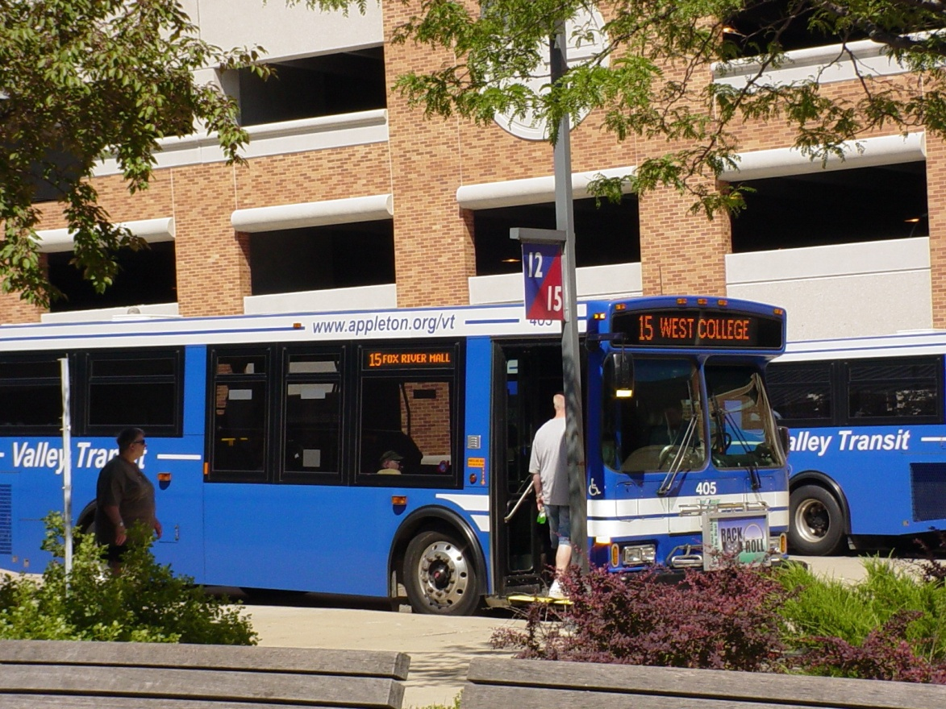
Public transportation today
29 buses
18 routes
1,095,650 trips provided in 2012
2% increase in ridership over 2011
Highest since 1995

Slide 6
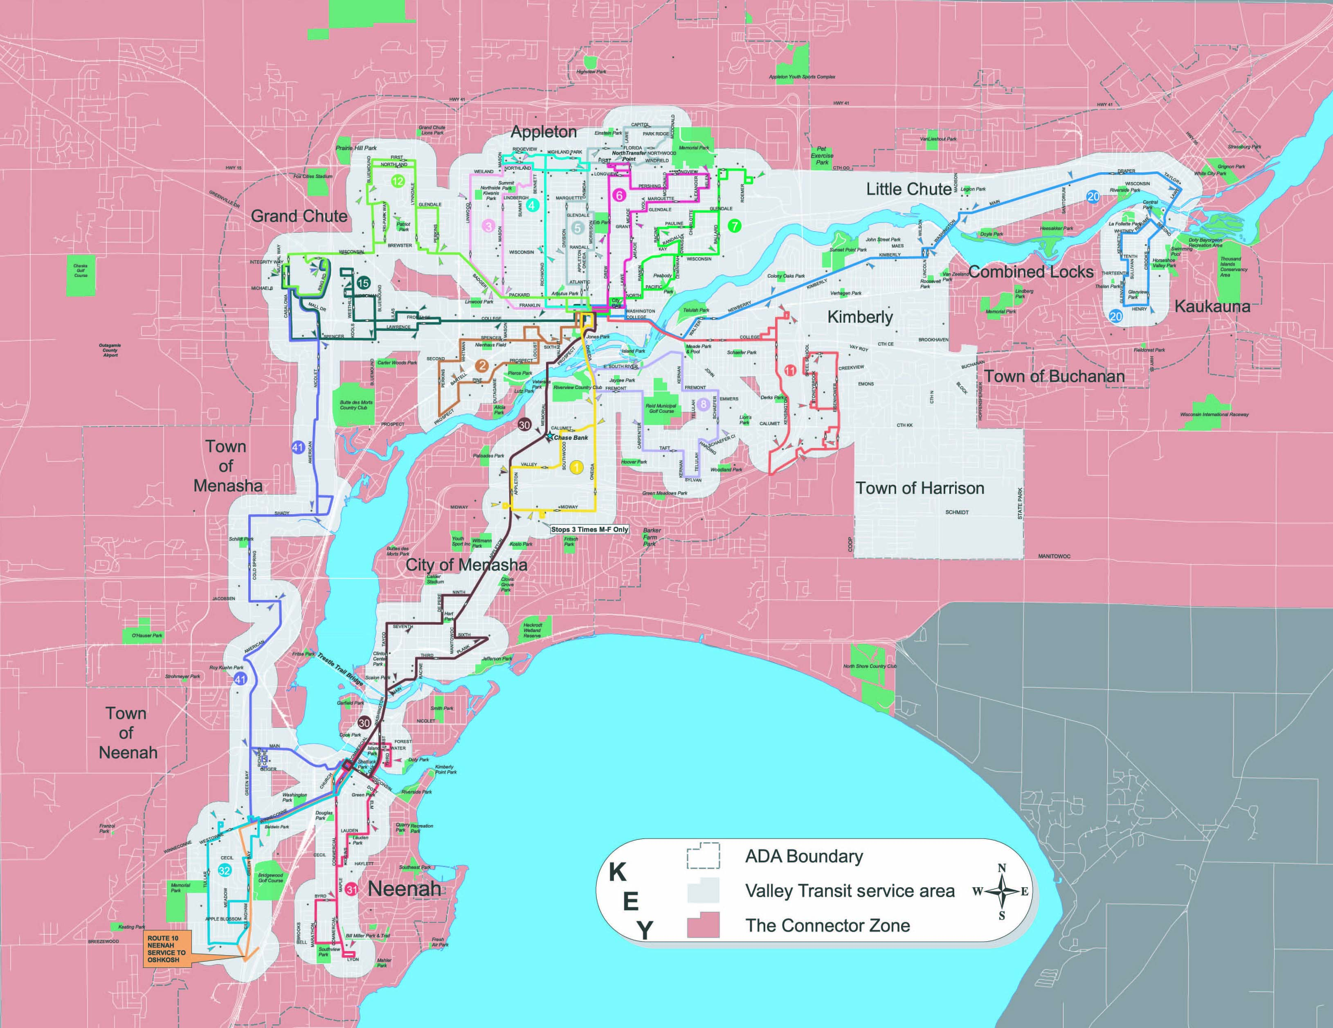
Valley Transit Fixed Route Service

Slide 7
Valley Transit II
The Americans with Disabilities Act mandates that transit systems operating fixed route buses provide alternate transportation (door to door, accessible, on demand service) for people who are unable to use the regular bus system.
If no fixed route service, there is no ADA service.

Slide 8
Valley Transit II ADA Boundaries

Slide 9
The Connector
Approximately
15,000 rides per year
92% of trips for employment
4% of trips for education
Through a partnership with United Way Fox Cities and
Valley Transit, this unique service was designed to help provide safe, convenient and affordable access to public transportation for Fox Cities residents who work second or third shift jobs or who need to travel beyond regular bus routes.
Paid for by United Way and several other local funding partners.

Slide 10
Valley Transit Funding
Owned and operated by City of Appleton
9 other municipal partners
3 county partners
Also receive funding from:
3 family care organizations
3 non-profit agencies
2 private businesses
Total of 21 local funding partners

Slide 11
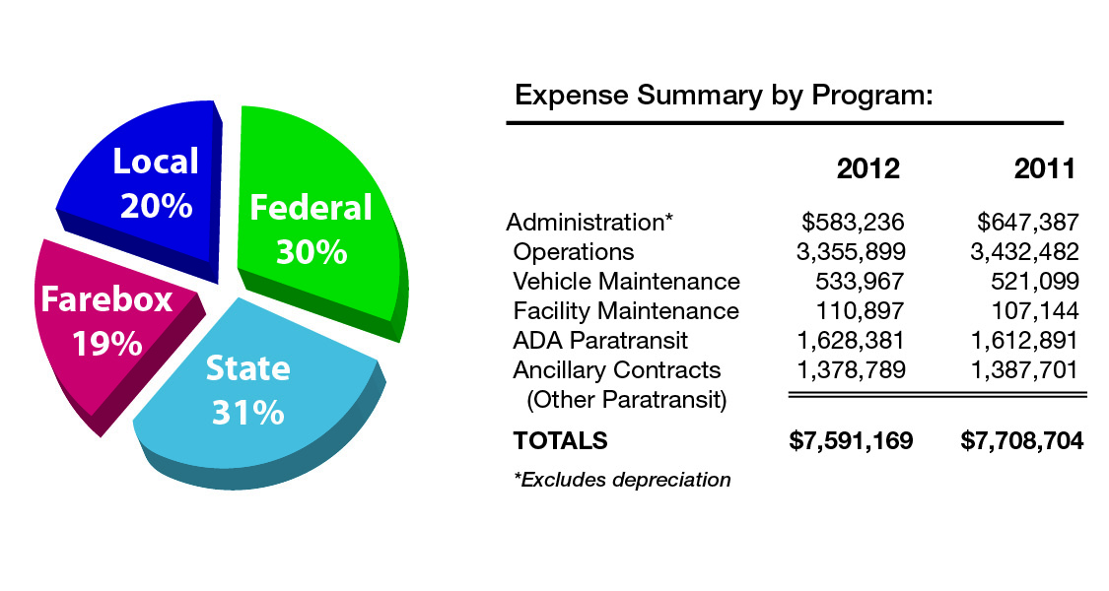
Valley Transit Funding

Slide 12
Challenges & need for
sustainable funding
Continued 10% State funding cut for 2014
State budget reduces local funding alternatives and adds new hurdles to gaining dedicated local transit funding by locking in the property tax levy limit.
5339 Bus and Bus Facilities dollars do not provide enough dollars to even maintain current assets.

Slide 13
This comes at a time when transit ridership is on the rise.
40% of trips taken with Valley Transit services are for employment.

Slide 14
Alternatives for Valley Transit
Increase cost to local funding partners
Cut service
Raise fares
Continue to cut costs of providing service – more difficult every year
Find local dedicated source of revenue for transit

Slide 15
Questions?

