Slide 1
The Faces of Transit
Stephanie Gyldenvand
Associate Director, WISDOM

Slide 2
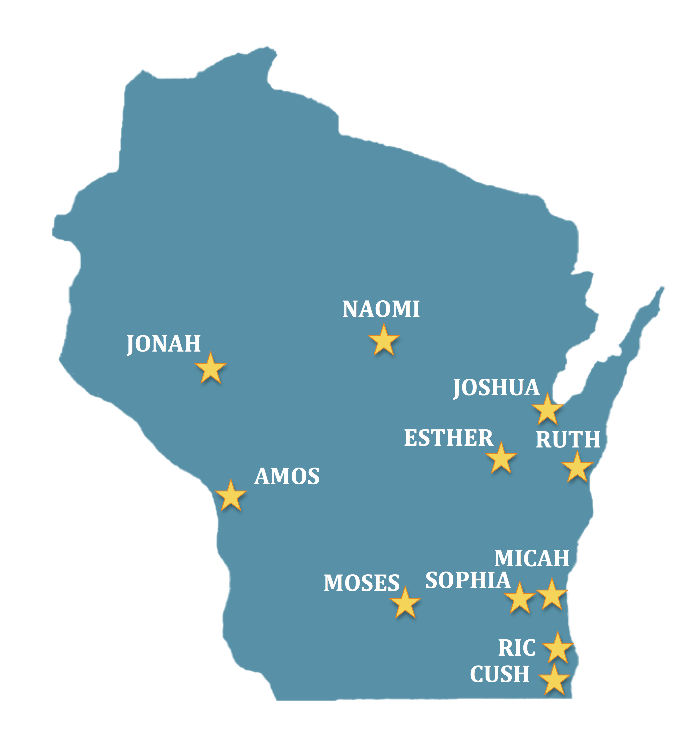
150 Congregations
11 affiliates across the state
Focus on systemic issues of poverty and injustices
Local, state, national impact
www.wisdomwi.org

Slide 3
Transit Issues
Local route and service cuts
State budget; transit funding and source of funding
Regional Transportation Authorities (RTAs)
Federal flexibility in operating assistance
Federal transportation funding
Roads vs transit; Milwaukee Zoo Interchange

Slide 4
Who accesses transportation services?
Workers
Students
Seniors
Disabled persons
Those that cannot afford a vehicle, families without a second/third car, and those that cannot drive
Millennials and those that chose transit

Slide 5
Where are people going?
Statewide Transit Rides by Purpose
WIS DOT Study 2003

Slide 6
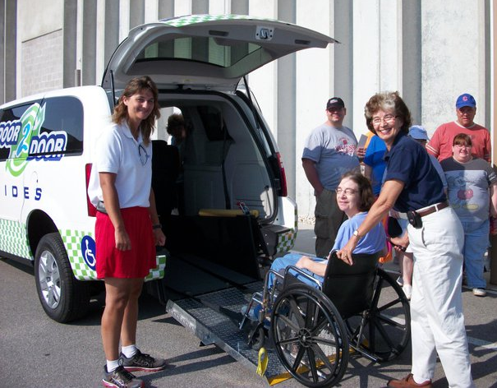
Many modes of transportation
Fixed route bus systems
Non-emergency medical transit
Rural bus service and consortiums
Shared Ride Taxi
Volunteer programs
And many more…

Slide 7
What happens when transportation is limited?
Less options for employment by location and in hours of work; results in lower wages
Strain on families to get children to school and difficulty to access job training and higher ed.
Poor access to medical facilities, fewer options for treatment and preventative care
Negative economic impact on local businesses, little access to quality nutrition
Isolation

Slide 8
Transit riders share

Slide 9
Building Relationships to Strengthen Transportation
Transit Riders – seniors, disabled, workers, students, etc.
Non-profit organizations, faith communities
Local government
Transit providers and workers
Regional planning
Business owners
The greater community

Slide 10
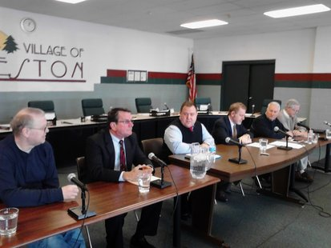
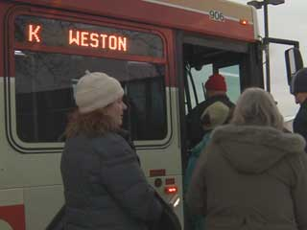
The Weston Story

Slide 11
Why is Weston different? It’s not!
In 2011 the Weston Village board ended bus service due to cuts in the state budget
Schofield and Rothschild cut service because service cost more due to Weston ending service
In 2012 a judge ruled that the city carry out a ballot measure after required signatures were gathered
Weston voted in favor of bus service and local riders worked with the Village to negotiate service level
In January 2013 bus service returned to Weston, brining Schofield and Rothschild as well

Slide 12
Working Together

Slide 13
The Future of Transportation Services
Demand for many modes of transportation access in urban and rural areas will increase
Funding from state and federal sources is insecure
Local communities will have to work together
We need to build a broad coalition that includes local government, transit providers, riders, businesses

Slide 14
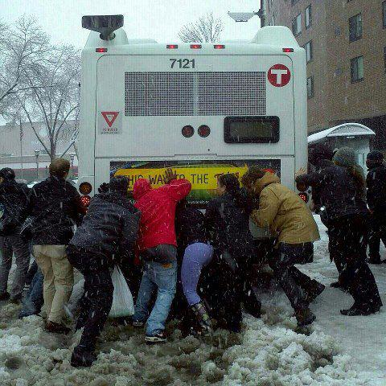
We must all work together

Slide 15
Stephanie Gyldenvand
Associate Director, WISDOM
920-216-0891
stephanie.wisdomwi@gmail.com

