Slide 1
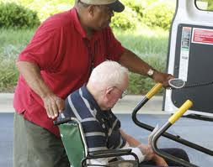
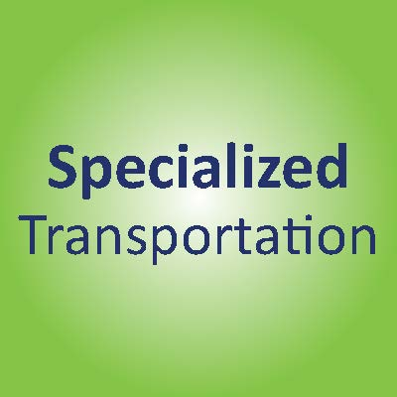


Carrie Porter
Transportation Specialist
Greater WI Agency on Aging Resources

Slide 2
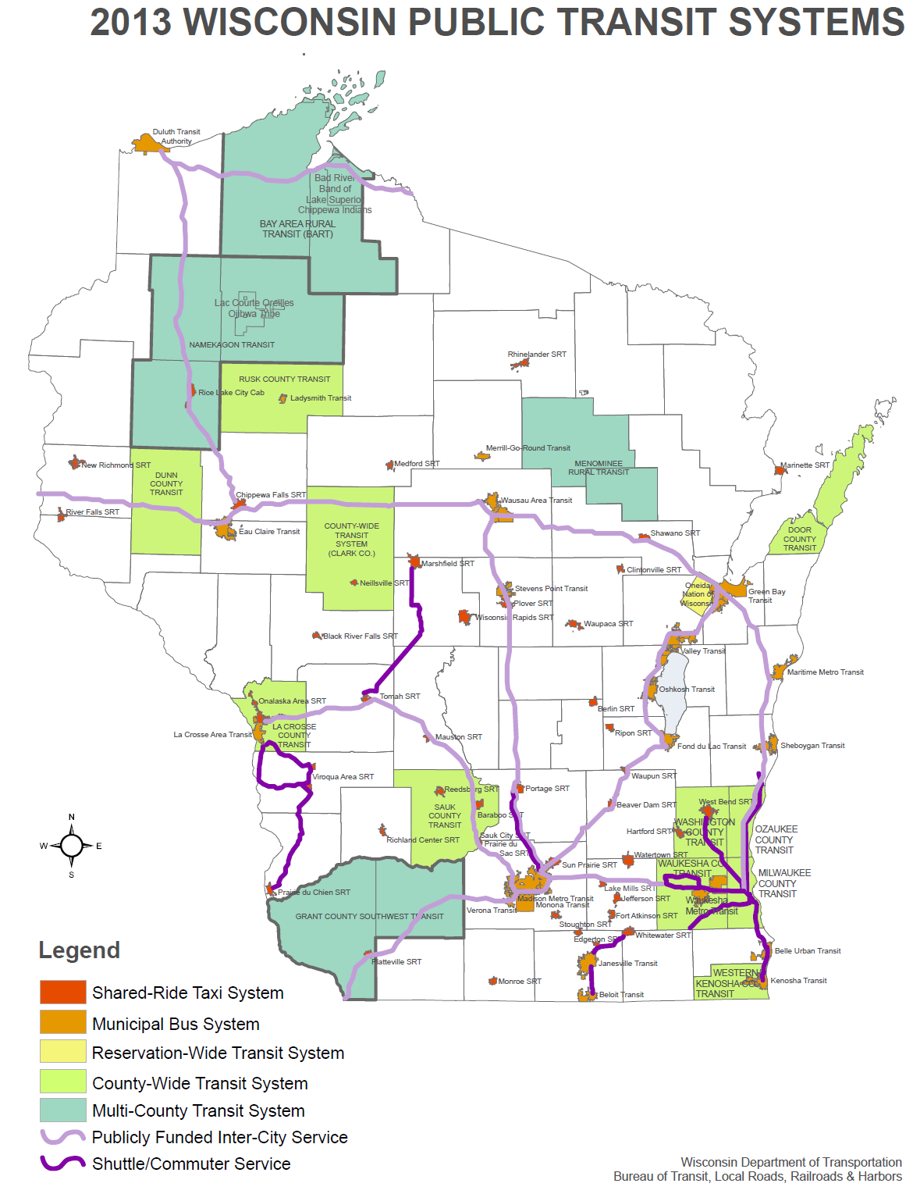

Slide 3
Definition of Specialized Transportation
“Specialized transportation services” means a transportation system, either publicly or privately owned, which provides to elderly or disabled persons general or special service on a regular and continuing basis in a designated service area.
WI state statute 85.21

Slide 4
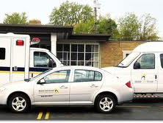
Specialized Transportation Providers
Notes:
Lutheran Social Services

Slide 5


Specialized Transportation Funding
Local – tax levy, foundations, fundraising
State – 85.21, 85.215
Federal – Federal Transit Administration & Medicaid
  ***Coordination!***

Slide 6
Benefits of Transportation
Individual
Community
  Economic driver
  Employment
Healthcare
  Physicians, long term care facilities
Tax payers
  Medicaid
  Local tax dollars

Slide 7
Key Issues for Specialized Transportation
Adequate funding
Coordination
Non-Emergency Medical Transportation NEMT brokerage
Federal surface transportation bill

Slide 9
Carrie Porter
Greater WI Agency on Aging Resources
Carrie.porter@gwaar.org
608-228-8092

